Slide 1



Everybody
can THRIVE
Insights for the 10 Year Plan for Health
Accessible
Person-centred
Competent
Trustworthy
Septmeber 2024

Slide 2
The good care framework
The good care framework was developed from what local people told us in our Big Conversation.
What does good care look like?
We asked local people open-ended questions about what good health and care means to them. At community events and in focus groups we helped local people to draw out what their own vision of good care would look like.
We took what they told us and and started to use qualitative data coding to identify themes, these themes eventually developed into the good care framework and our four pillars of good care, or four aspects of what makes the difference between good care and inadequate care. We also looked at the wider issues that impact good care at a society level-the wider determinants.
Everybody
can THRIVE
Accessible
Person-centred
Competent
Trustworthy

Slide 3













What does good care look like?
The Big Conversation
Appointments for acute issues AND routine check-ups are available within a reasonable timeframe
Health and care services both RESPOND TO and ANTICIPATE people’s needs
Barriers to accessing care are understood and addressed:
  Disability (physical, sensory, or mental)
  Language barriers
  IT literacy
  Knowledge barriers
  Costs, including hidden costs
Patients get REASSURANCE that they are well
Trustworthy
Accessible
Health and care services are ACCOUNTABLE to patients and local people
GOOD CARE IS
Patients get to make appointments and be seen in a way that works for them
Services are inter-connected around the patient, not just centred on a condition or specialism
Patients’ WORRIES and CONCERNS are understood and addressed.
Competent
Person-centered
Services work well with each other, at community level/ beyond just health and care
CULTURAL DIFFERENCES in expectations of what care should look like are taken into account.
There is CONTINUITY OF CARE between services and within services
Patients understand how care decisions are taken and believe professionals are providing good treatment
There is CONSISTENCY of care, quality of care does not vary based on individuals and staff turnover.

Slide 4




























What does good care look like?
Follow-on, ongoing support
Affordable care
Everybody
can THRIVE
Good care is: trustworthy
Trustworthy
Accessible
Person-centred
Competent
Good care is: accessible
Follow-on, ongoing support
Follow-on, ongoing support
Good care is: person-centred
Reassurance, supported self-care
Accountable care
Affordable care
Improved air quality
Improved booking systems
Patients having a choice about where/ how they access care
Good care is: competent
Listening to patients, honest and empathetic care
Convenient locations
Collaboration beyond health and care
No gatekeeping
Improved air quality
Shared medical records, consistency of care
Collaboration beyond health and care
Adequate staffing - skills and numbers
Communication
Availability of appointments
Anticipative, not just reactive care
Adequate staffing
Accessibility-
disabled
patients
Patient involvement
in treatment options
Services that
know / understand specific conditions/ medical needs
Adequate funding, resourcing, facilities
Convenient opening times
Holistic approach to care
Health and care services working with each other
Improved air quality
High quality care
Continuity of care
Services that
know / understand patients’ cultural and social needs
Prompt, efficient diagnosis process
Evidence-based medicine

Slide 5
Hospital to community
  Experience of access to services, including long waiting times, impacts the level of trust people have in the service, which in turn impacts perception of the quality of care. If people feel they can’t access primary care when they need it, and that the quality isn’t as good, they will continue to overuse hospitals.
  A simple, straightforward and transparent process for accessing care across the hospital and community is needed.
  People want to feel that their care is well managed by a consistent team and that they can access the information that’s important to them easily without having to understand the complex systems of multiple service providers. Requires improved administrative processes within and between services.
  Anticipative care- feeling that you are being checked up on, looked after before issues escalate. Support to understand how to use systems when needed.
  More seamless interface between GP and hospital with reliable shared patient records
  Timely availability of accurate diagnostic investigations.

Slide 6
Accessible
Good care is: accessible
What would indicate accessible care?
What would NOT happen
Patients going to A&E for issues that could have been dealt with by a GP or primary care walk-in centre.
Patients can reliably access both routine and urgent care within a reasonable time frame, commensurate with their clinical urgency.
Over-stretched telephone lines, associated with attempts to implement a one size fits all booking system.
There are multiple equally reliable ways of booking appointments, taking into account both the needs of those who are most comfortable using online services and of those who are digitally excluded.
Services are available locally or within reasonably commuting distance; the needs of patients who don’t drive are taken into account.
Services are available at different times, to meet the needs of patients who work full-time, as well as those who work irregular shifts/ non-standard hours and those with caring responsibilities.

Slide 7

Accessible
Lack of access to GP appointments impacts other services
National GP Patient Survey- North East London practices
BEFORE TRYING TO MAKE A GP APPOINTMENT:
AFTER TRYING TO MAKE A GP APPOINTMENT AND NOT RECEIVING ONE
12% called 111
16% called 111
22% used 111 online
16% went to A&E
22% spoke to a pharmacist
6% used 111 online
29% tried to treat themselves at home
13% contacted the practice again
Practices where more patients tried calling 111 or speaking to a pharmacist BEFORE trying to get an appointment were less likely to receive overall positive feedback in the survey.
31% did nothing
Only 7% say the practice helped in a different way.

Slide 8

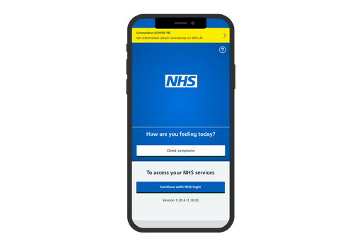








This resonates with feedback we have heard directly from patients
Accessible care means NOT being passed around between services

Slide 9



Local people came up with solutions for making primary care more accessible
Closer links between GP surgeries and community services; community health advocates, co-located advice services, care navigators or social prescribers could potentially respond to this need.
Routine check-ups- akin to a health MOT- for various groups such as young children or people with long-term conditions
Urgent primary care available on a non-appointment basis, for example in urgent care centres, walk-in centres or even an online live chat facility.
They should explain everything that I need to know, and offer support if I don't know how to do certain things - such as filling out forms. A lot of people are illiterate and can't do that - the system should help you proactively As it is, people have to pay private services or ask friends and family for help with that.
Better access to GPs and healthcare facilities, walk in hubs that people can access which run 24/7 so less pressure on A&E and less serious illnesses can be seen/sorted quicker. This will of course require more staff who need to be paid fair wages
I was called for a routine mammogram and this was carried out fine but I feel the opportunity could have been used for basic checking of weight and blood pressure etc., same when I visited my doctor for smear test I had the test no problem but why weren't basic health checks carried out.
Out of hours service is good but even they don't always have appointments. Appointments do need to be available in the evening to and we need to get referrals.

Slide 10

Good care is: competent
Competent
What would indicate competent care?
Specific areas of training identified as needed/ important
Clinical staff have up-to-date, in-depth knowledge of the conditions they are treating.
  Mental health and mental health-related disability.
  Neurodiversity, particularly autism.
  Sensory disabilities.
  Women’s health, particularly around menopause, endometriosis and severe period pain.
  The “younger older people” cohort- age 50 to 64.
  LGBT health and culture.
Clinical staff have a good working knowledge of patients’ conditions, even outside their area of specialty, to the extent they impact patients’ access to care, care needs and general wellbeing.
All GP surgery staff have a good working knowledge of health inequalities, social inequalities and cultural issues that may influence patients’ access to care.
Go on a course about LGBT people and take it to heart. Don't make assumptions about what queer people look like.
Understand autism and make adjustments. Staff currently don't!
Better deaf awareness eg lowering face mask, facing me when speaking Better understanding of the physical effort of attending appointments Better understanding that a patient may have multiple different needs eg someone under psychiatric care may also have hearing loss etc - being sensitive to multiple needs at once
As a woman, I think there is an awful lot more that can be done to support women with pain and mental health issues. More information about menopause and fertility issues - don't just fob us off without exploring what can help us!

Slide 11
Good care is: competent
Competent
What would indicate competent care?
What would NOT happen
Patients being diagnosed accurately and within a reasonable timeframe.
Excessively long waiting times for diagnosis/ investigations.
Admin issues affecting the diagnosis process, such as lost test results.
Availability of necessary investigations for ensuring accuracy of the diagnosis process.
Misdiagnosis as a result of superficial consultations or lack of knowledge.
Patients receiving treatment informed by the NICE guidelines, and by the latest evidence-based developments in medical science.
Lack of support with symptoms during an ongoing/ potentially long diagnosis process.
Clinical decisions being taken based on factors such as budget constraints or professional’s own cultural biases, rather than clinical need and scientific evidence.
You need expert information to be understood. You need to know what you're talking about. It's knowing where you are in the system, how long it will take and what's appropriate to do while you wait. Provide services according to NICE guidance. It seems they can't do that at the moment because of money, staff or lack of knowledge.
“Some health professionals’ culture and religion comes first, rather then what the young people are telling you, if you are asking for contraception they look at you like you should not ask for it, as its obviously against their religion to have sex before marriage.
Healthcare professionals need to have an understanding that negative test results don't mean that symptoms are not life changing.

Slide 12
Person-centred
Good care is: person-centered
What would indicate person-centred care?
What would NOT happen
Patients get to see the same medical professional consistently (for example the same doctor or nurse), as much as it is practical.
Patients receiving contradictory information from medical professionals.
Patients feeling like the level of care they receive is dependent on whom they get to see on any given day.
When patients see different medical professionals within the same practice or there is a staff turnover, notes and patient records are passed down and read. Quality of care remains constant regardless of who is delivering the care.
Patients having to repeat information that should be in their medical records or notes already.
Referrals to other services are issued as needed and processed promptly; GPs and other services share medical records and information seamlessly.
Patients feeling like they are passed around between services with no actual help.
GP surgeries are actively working with the wider community to promote holistic patient health - social prescribers, the voluntary sector etc.
Often health care providers give contradictory information which is frustratingly vague and confusing .

Slide 13
Person-centred
Good care is: person-centered
What would indicate person-centred care?
What would NOT happen
Patients feeling that thy are treated as a partner in their own care; and that medical professionals are interested in their own desired health outcomes.
Patients feeling like they don’t have sufficient information to make informed decisions about their care.
Medical professionals giving patients clear options for treatment or care, presented objectively with pros and cons; empowering them to make informed decisions.
Patients only being allowed to discuss one symptom or condition per appointment.
Medical professionals taking a holistic approach to patients’ health rather than examining conditions and symptoms in isolation.
Involve me in everything about me and make communication easier and transparent .
Patients getting a choice about where and how they access GP services (using online services, having remote consultations or doing everything in person)

Slide 14
Good care is: trustworthy
Trustworthy
What would indicate trustworthy care
What would NOT happen
Patients feeling listened to and reassured that their problems are taken seriously by care professionals; being given adequate time .
Patients feeling like they are fobbed off or their concerns are dismissed.
GP services proactively engaging with patients and asking about what is important to them.
Patients feeling that they are treated like a burden; feeling discouraged from seeking care or asking questions.
Patients having someone they can turn to for competent advice, reassurance and prevention.
Consultations feeling more like a tick-box exercise than like a consultation.
Patients communicating with professionals about their care, in a honest, straightforward manner; understanding why they are offered a certain course of action.
I want someone who will look at me and listen to what I need. Not stare at a computer screen. They used to have time to do that.
A simple, straightforward and transparent process for accessing care.
Services demonstrating accountability and acting upon feedback received from patients.

Slide 15


Good care is: trustworthy
Trustworthy
Focus on trust, communication and avoiding gatekeeping
TRUST
Experience of access to services impacts the level of trust people feel they can have; which, in turn, impacts perception of the quality of care.
At worst, when trust is eroded, patients may feel like services don’t want to provide the best care they can, but just the minimum they can get away with, and the processes through which care is accessed start to feel like gatekeeping.
Quality
of
service
Access
to
service
Most notably:
Admin staff in GP surgeries triaging patients on the phone.
Doctors are good but the ones I have problems getting through are the receptionists at my GP. They lie, and are a law on their own.
Good care means not just being sent texts or asked to fill in lengthy forms for triage before you are even considered for an appointment.
Long and complex e-consult forms.

Slide 16
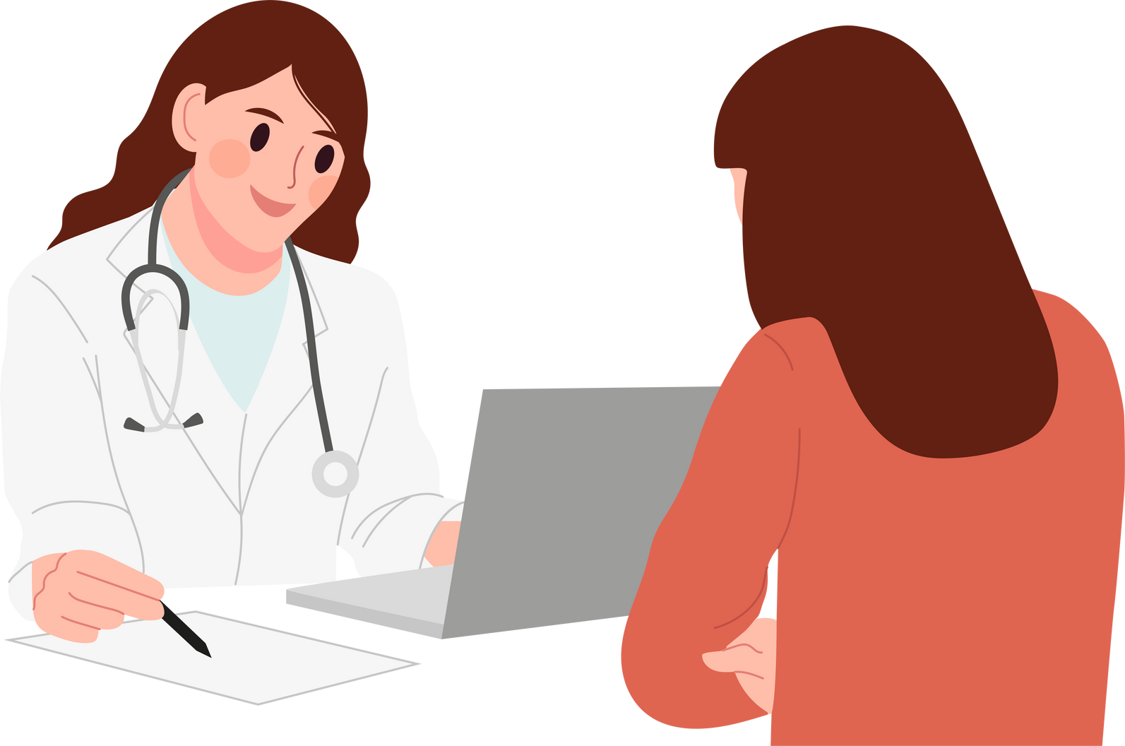
Good care is: trustworthy
Trustworthy
The big challenges
Patients, especially parents of small children, people living with long-term illness and the elderly, may not feel certain about how to tell whether they are well, or whether they are experiencing worrying changes in their health.
Changing patient behaviour around how they access care may play a crucial role in reducing demand for care; but in order to change patient behaviour, we must first understand their motivations and gain their trust.
Anticipative and trustworthy care can provide them with reassurance and confidence. This could entail:
Providing reassurance (what’s normal, what’s not) and educating on self-care.
When patients are told that they may need to wait longer than expected for an appointment, or advised to take over the counter painkillers to manage their symptoms- are they going to TRUST that it is safe for them to wait?
Prioritising prevention over reactive care; proactively offering check-ups, routine investigations or other forms of care and support.

Slide 17


What does good care look like?
Don’t gatekeep care
Trustworthy care
Accessible care
regular check-ups
expectations management
Pluralistic model of access to care
Problem-solve promptly
Listen to patients
Adequate staffing, funding, resourcing
Cultural competence,
Reassurance, explaining,
Competent
care
Person-centered
care
Be aware of specific needs
medical, social and cultural

Slide 18
Analogue to digital
  A large group of people want to use digital services and find they lead to a better experience. However there are groups who find it difficult or expensive.
  Systems need to build in flexibility for people to be able to choose the option that suits them at the time.
  There are a multitude of digital tools being adopted by different service providers which is adding to the confusion for patients.
  People using health services the most are the ones most likely to have digital difficulties e.g. people with multiple long-term conditions.
  Carers find it difficult to manage multiple people through digital means
  Cost is a key aspect for some groups - homeless, refugees.
  Not clear the balance is right re face to face and online appointments or that patients understand the process.

Slide 19
Person-centred
Good care is: person-centered
GP extended hours survey
Some people prefer to use GP surgeries in a very traditional way:
Others are willing to be more flexible about how they access primary care:
- booking GP appointments online, using online tools, having remote consult, going to a hub or an Urgent Treatment Centre.
- booking GP appointments by telephone, being seen in person, always going to the same GP surgery.
They are likely to be aged under 50; if they are long-term ill or disabled, they are likely to be more independent or their conditions may be less severe.
They represent the majority of our respondents, but only by a small margin.
The ways in which they are willing to be flexible may vary between groups and individuals (for example, some may be willing to travel to a hub but not to have video consults, or the other way around.
They are likely to be older, disabled or more severely ill, digitally excluded.

Slide 20


Person-centred
Good care is: person-centered
GP extended hours survey
We have analysed data on where and how patients want to access GP appointments.
Patient Profiles
Prefers to be seen in person
In-person local
In-person will travel
  Needs in-person appointment within their local area
Highly values in person appointments and is willing to travel for them
  Older people, digitally excluded
45%
  Young people, aged 18-24
28%
  South Asian
  Living more than 30 minutes from GP; transient, likely to move within the borough/area
  Some disabled people, particularly those with sensory impairments or whose disabilities are severely limiting.
of respondents
of respondents
Only willing to travel up to 30 min
  In work, who may be able to access care near their workplace rather than their home.
  People in low incomes, who may not afford internet access, nor further travel.
  White other than British ethnic groups; Latin American ethnic groups.
Virtual
Flexible
Willing to travel 30+ min
  Seeks to avoid travelling to see a GP, but willing to have remote appts
Happy to have virtual appointments or to to a GP
  Some disabled people; especially those with mobility impairments or relatively well-managed, stable chronic conditions.
16%
  Roma ethncity if not digitally excluded.
12%
  Some neurodiverse people, including some autistic or diagnosed with ADHD.
  Some neurodiverse people, including autistic people & those with mental health conditions.
of respondents
  Already living further away from GP
of respondents
  Aged 25 to 49
  LGBT patients
  Parents, especially working parents.
Prefers being seen remotely or doesn't mind

Slide 21




Patient profiles
Person-centred
Based on GP extended hours survey and previous Local Voice engagement
Least flexible
In-person patient
Virtual patient
Most flexible
Most flexible
Specifically needs in-person appointment within their local area
Highly values in person appointments and is willing to travel for them
Seeks to avoid travelling to see a GP, but willing to have remote appts
Happy to have virtual appointments or to travel to a GP appointment
In poor health or limited a lot by disability; as well as full-time carers.
Living more than 30 minutes away from their GP; transient populations.
Neurodivergent (autistic, ADHD) or experiencing mental health issues
LGBT
Neurodivergent (autistic, ADHD)
Older people
Young people (under 24), students.
Living with a stable and relatively well-managed long term condition or disability.
Non-religious
Sensory impairments (sight or hearing)
Usually in good health, experiencing new or acute symptoms.
Living more than 30 minutes away from GP
Aged 25 to 49, millenial generation
On low incomes, would struggle to afford public transport and/or internet access
White non-British or Latin American ethnicities.
Parents of young children, especially working parents
Asian ethnicities, especially Bangladeshi or Pakistani

Slide 22
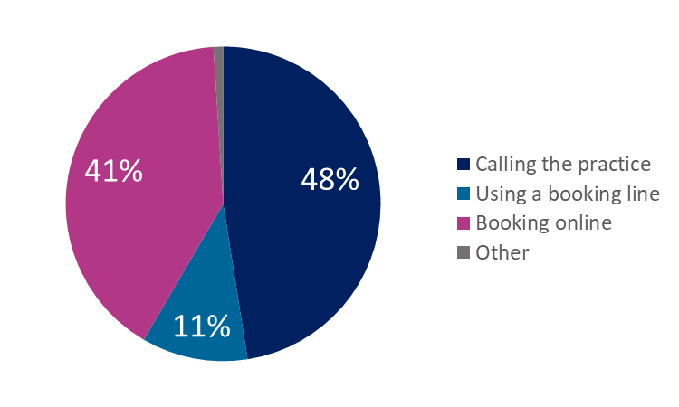
Person-centred
How do people prefer to book appointments?
GP extended hours survey
More likely to prefer online
  Chinese (61%)
  Lesbian, gay, bisexual or pansexual (60%)
  Aged 25 to 36 (58%)
  Diagnosed with ADHD (59%)
  Atheist or no religion (57%)
  White ethnicities other than White British (53%)
  Living with a mental health issue (46%)
  Jewish (46%)
  Latin American (46%)
Less likely to prefer online
  Roma or traveller (13%)
  Disabled (35%), particularly if limited a lot (30%) or sight impaired (30%)
  Black ethnicities (32%), particularly African (28%)
  Bangladeshi (34%)
  Aged 50+ (34%)
  Caring responsibilities more than 20 hours/ week (34%)

Slide 23
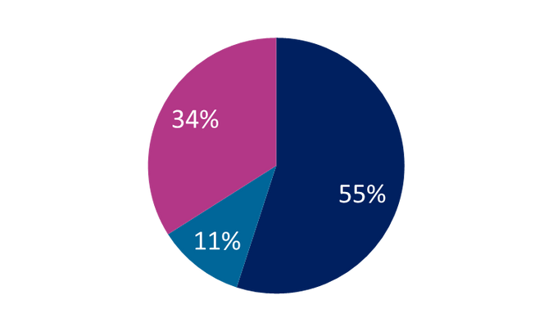
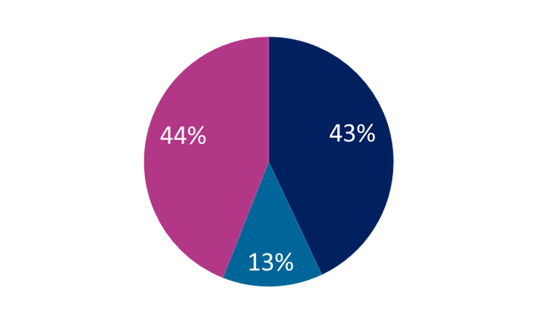
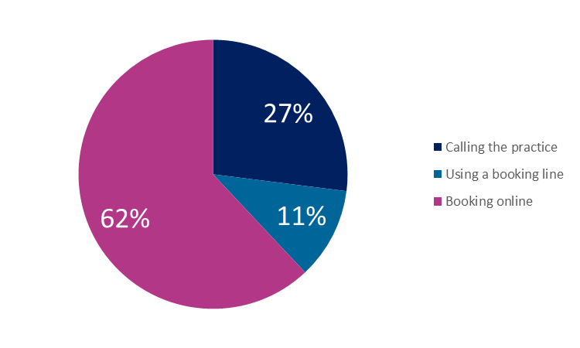
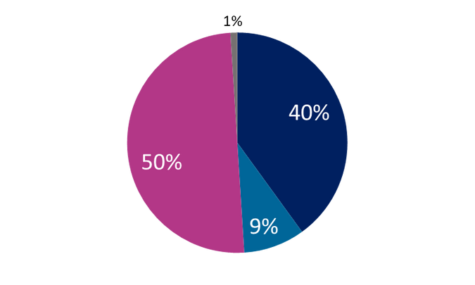
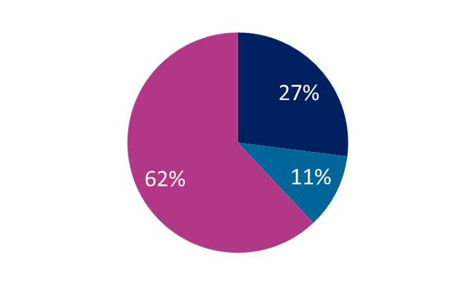
Person-centred
How do people prefer to book appointments?
GP extended hours survey
Least flexible
The in-person patient
Specifically needs in-person appointment within their local area
Highly values in person appointments and is willing to travel for them
The virtual patient
Most flexible
Seeks to avoid travelling to see a GP, but willing to have remote appts
Happy to have virtual appointments or to travel to a GP appointment

Slide 24









Unblocking the pipeline
Emergency appointments, routine screening,
able to refer to other services
Borough-wide
GP service, near good transport links
A
radical
new approach
may be the
answer
Online services
(booking, repeat prescriptions, etc)
Provide reassurance
Remote appointments,
GP at Hand model
Repeat prescriptions, specialist advice for long term conditions
OWN GP
NHS 111 and other centralised services
Extend 111 remit with better skilled call handlers
Better info on accessing the right GP service
Social prescribing
Advanced algorithms
for diagnosis and
reassurance, linking up to relevant services if needed
In-person appointments-prioritising long term conditions and the most vulnerable
AI and digital information
Wider integration
Wider community
Info on prevalent conditions(Strep-A, Covid, flu) in multiple formats: written, audio, phone line etc.
Info on prevalent illnesses
Health checks
Support groups

Slide 25


What we know about digital inclusion in North East London
During the Covid-19 pandemic, many healthcare, social care and community services started to offer an online provision; either complementing or replacing their face to face services; post-pandemic, there are lessons to be learned about maintaining and sustaining this change without leaving anyone behind.
The opportunities
The risks
Online provision can streamline services, make them more efficient and more likely to share resources (for example, in a GP hub)
Some local residents don't have the knowledge to access online services.
Some local residents don't have access to devices they need to access online services.
Online services may be more accessible to some disabled people (e.g. mobility impaired, housebound, extremely immunosupressed etc.)
Some local residents don't trust online services.

Slide 26
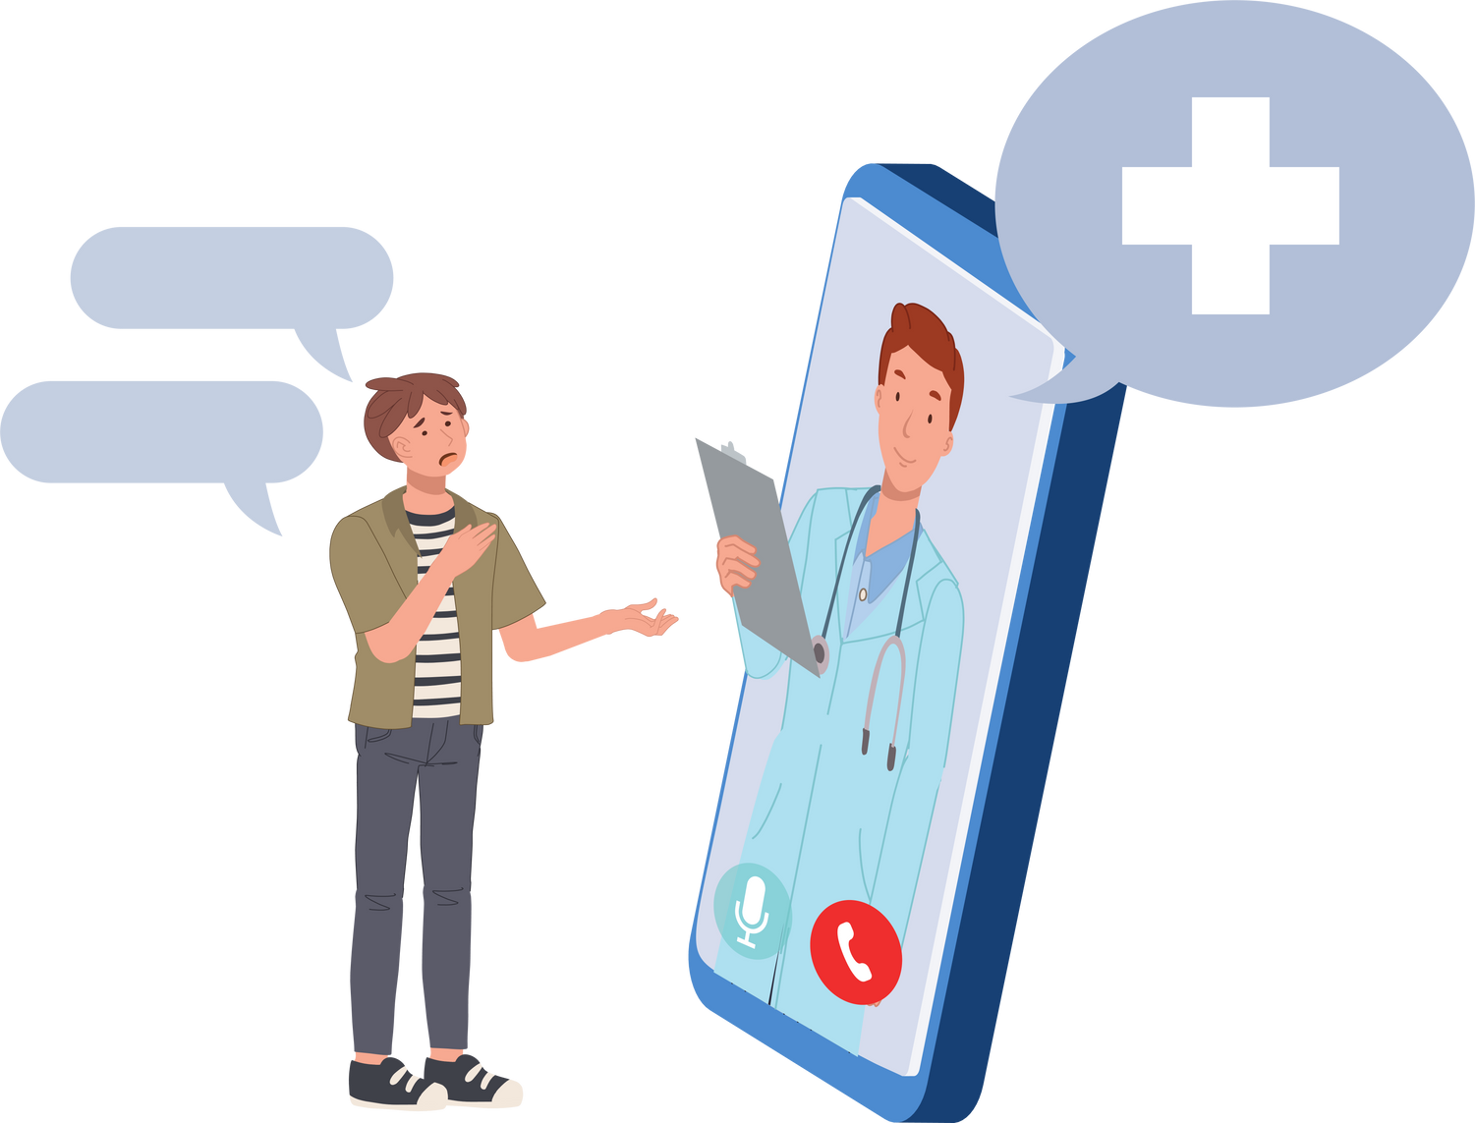
Focus on opportunities
Reduced commuting time may reduce the overall amount of time patients need to spend on accessing the care they need.
Use of online booking and e-consult can reduce dependency and pressure on phone lines, making the booking process more accessible and user-friendly, providing that it works as intended.
""NHS communications during the Covid-19 pandemic have all been satisfactory and saved me long journeys."
"It's an absolute nightmare phoning any surgery at 8 am. I hate it. So I found out about e-consults and the surgery has been prompt and replies within 48 hours sometimes next day. Thank you to my GP for keeping on top of your workload and replying to e-consultations on time and effectively.
"You can make bookings online and order prescriptions online which makes life so much easier."
Use of online technologies allowes for the possibility of visual diagnosis, unlike phone consultations.
"It's an absolute nightmare phoning any surgery at 8 am. I hate it. So I found out about e-consults and the surgery has been prompt and replies within 48 hours sometimes next day. Thank you to my GP for keeping on top of your workload and replying to e-consultations on time and effectively.
"Had to have a telephone consultation during Covid and the lady Doctor was lovely; had to video call to see the area that needed treatment and was prescribed something. Now I hopefully have a plan going forward.
Digitisation reduces and simplifies the bureaucracy around processes such as viewing medical records or reducing repeat prescriptions; making them easier for patients.

Slide 27

Focus on risks
The extent to which patients would be willing and able to learn to use online services varies based on individual circumstances.
Beyond knowing how to use the internet in general, ability to use health and care services depends on level of English, general literacy, knowledge of how services work bureaucratically.
"Digital services are great ie online portals etc, however, this really excludes the older generations who are not technically able. There must be more local classes to support them in being able to use technology. "
KNOWLEDGE
AND
ACCESSIBILITY
Patients whose understanding of online services is limited are less likely to trust them.
Patients who are not confident in their ability to access online services may feel discouraged from accessing them at all.
"I do not get on with computers ad technology. I would prefer to see a doctor face to face and preferably one who knows my history and does not use up my 10 minutes appointment talking them through my medical history"
"Older people tend not to trouble GPs when they really should. Making blood test appointments difficult as they don't have the technical knowledge or facilities"
ACCESS
TO DEVICES/ INTERNET
TRUST IN THE QUALITY
Patients who experienced difficulties accessing the healthcare they need may feel that introduction of online services is just another barrier or a way of cutting costs at the expense of access and quality.
The cost of living crisis and housing precarity affect people's access to internet and devices
Some local people may have concerns about data security/ privacy. This is especially a concern for those who don't have their own devices/ connection/access to a private space
"Stop believing technology improves services. Stop telling me I'm on a waiting list for my hearing aid and then nothing happens."

Slide 28
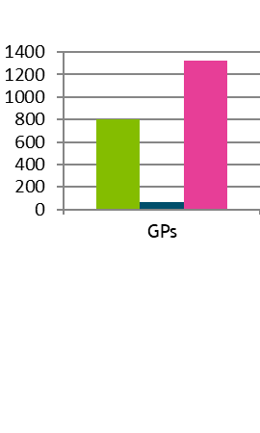
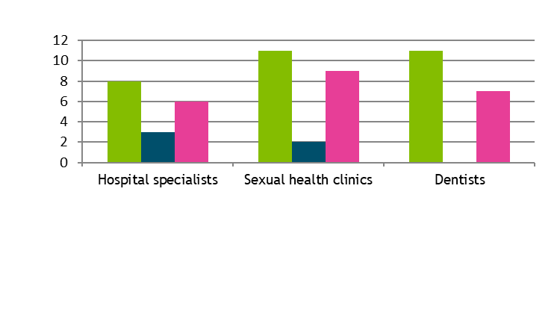
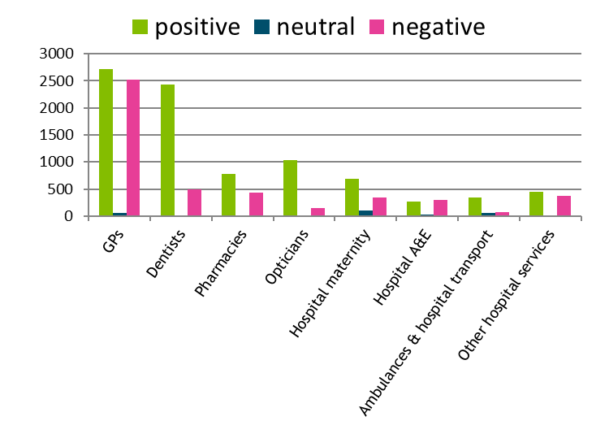


Experience of online systems
Most comments we received were about GPs
Online booking is not always available; even when it nominally should be in place, there are no slots available- this issue is particularly affecting GPs.
Where it is available and functional, patients find it easy and convenient to book online primary care or specialist services (such as routine dental appointments, medication reviews or blood tests).
There are also reports of GP econsult forms going unanswered; when this happens patients often use uregent care services such as 111 or A&E.

Slide 29



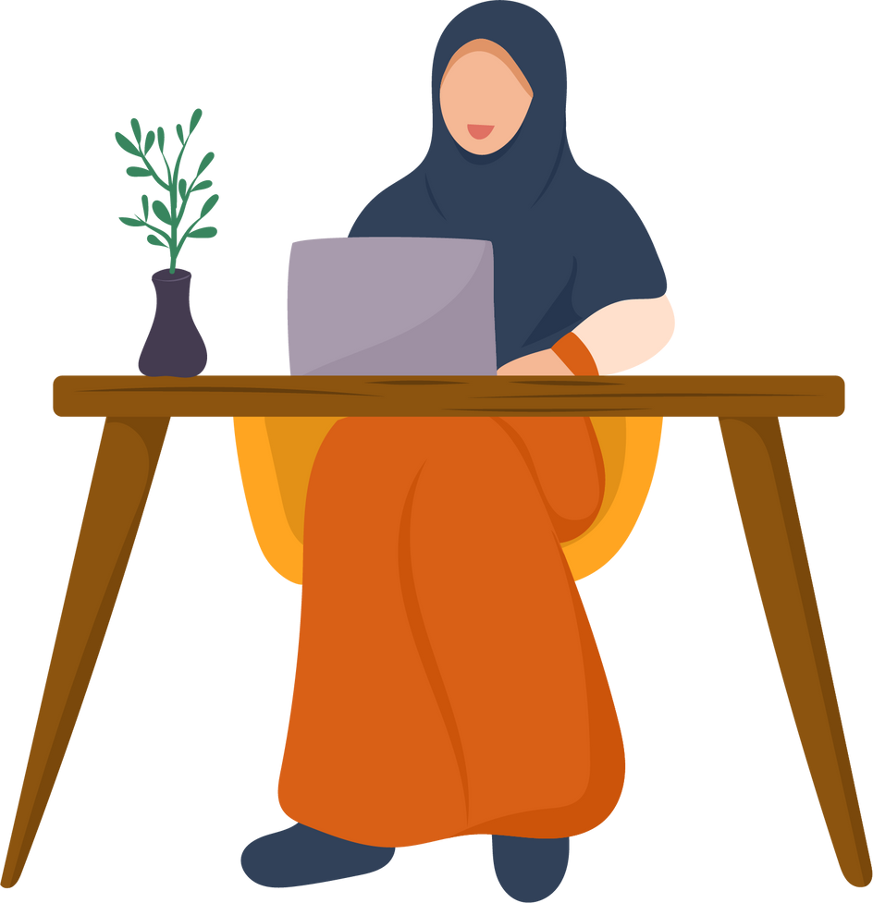
What we know about digital inclusion
Online NHS services are particularly helpful to:
Parents of young children, particularly working parents;
People aged 25 to 39 (Millennial generation);
Patients with well-managed, relatively stable long-term conditions, who require routine appointments and repeat prescriptions.
Patients with mobility issues who may struggle to travel.
They may be less suitable for:
Older people aged 65+;
People with lower levels of English fluency, IT literacy, familiarity with the NHS or general literacy.
People struggling financially, who may not afford devices.
People with sensory impairments or learning disabilities.
Patients experiencing new and unexplained symptoms or requiring extensive investigations; particularly if their illness is severe.
North East London residents of non-White ethnicities, particularly Black and Bengali, may be more likely than their peers to experience digital exclusion.ency, IT literacy, familiarity with the NHS or general literacy.

Slide 30



Focus on online GP services
These quotes are fictional, but are based on the aggregated experience of patients we have heard from.
WHEN THINGS WORK WELL
WHEN THINGS DON'T WORK WELL
I am able to book routine GP and nurse appointments online rather than having to wait on the phone queue; when I need to be seen urgently I use e-consult and get a reply promptly, either by telephone or video call. I can also use automated forms to order repeat prescriptions, view my test results and medical records.
My mobility is impaired; it's easier for me to not travel to the surgery, and during the Covid-19 pandemic I feel safer. I believe we should keep doing this after the pandemic ends.
Booking online appointments is no longer available. When I try to use the e-consult form, I answer 30 questions, only to be unable to send it: instead, I am told to call the surgery. The phone queue is very long and frustrating. If I manage to send the e-consult form, I wait multiple days for the doctor to get back to me by telephone. I don't have the option of an online consultation instead, so I can't show anything visual to my doctor without physically coming in.
The website is often down and there are technical issues.
I am entirely comfortable using online GP services and would like to do as many things online as possible.
Reception staff helped me set up my online account, and showed me how to use online services, so I am more confident. The applications are simple, straightforward and user-friendly. As a result, I started using online access regularly and I am happy with it.
I have a sensory disability, but the website is optimised for accessibility software and I have support from surgery staff, so I am able to use it.
I don't understand how to register for online access and no one tells me anything. I tried doing it once, but it required some paperwork that I was never able to communicate with reception about- they don't have time for me.
The appointments are very confusing and there are no tutorials explaining what to do. I have a sensory disability, and there is no support for people like me to access them.
I don't know
that much about online GP services. I have some reservations, but with the right advice I could use at least some.
Because a lot of other people use online services, the telephone lines are less busy than in other surgeries. I can book appointments, request repeat prescriptions or receive my test results over the telephone or in person.
I can't book an appointment over the phone- they keep telling me to use the e-consult form. Because I don't have internet and can't do that, I started calling 111 or going to A&E when what I really need is a GP appointment.
Even when I clearly need to be seen in person and physically examined, I'm still only given online appointments.
I never use the
Internet at all.I need to be able to access all the GP services I need without going online.

Slide 31
What local people are saying about online GP services
Feedback from people satisfied with online GP access
Feedback from people disatisfied with online GP access
I used an e-consult form. Very efficient - completed the e-consult form and had a call back within two hours. Had to provide a sample to the practice and had initial results within another two hours. Would be happy with this service in normal life as well!
The e-consult facility is often a waste of time. I have completed endless e-consults and half the time I get nowhere because they ask me to ring the surgery instead. When I ring the surgery they ask me to complete an e-consult. Many times I have gone round and round in circles getting nowhere.
(Redbridge patient)
(Tower Hamlets patient)
Had my annual diabetic review virtually, it is impossible to do feet checks that way.
Made an online booking and received a call from the GP, who then set up an online consultation through a text message. Everything happened very quickly and I am very pleased with it.
(Tower Hamlets patient)
E-consult is very difficult to complete with a visual impairment. Telephone lines are extremely busy.
(Hackney patient)
(Tower Hamlets patient)
While it's overall harder than before to access my GP, I have noticed some improvements-booking blood tests online for example.
I have had to contact the surgery six times in last two months for my 8 year old son .. they can’t offer a face to face appointment which I find so strange! I have been told this is how the surgery will continue to be.
(Havering patient)
(Tower Hamlets patient)

Slide 32

Preliminary findings from a recent survey with 71 City residents on digital access found:
  Number of apps/digital platforms that are now used is confusing. In the City residents have at least 10 different apps to access their health information.
  The different apps/platforms not talking to each other, therefore having to access several to get information needed.
  Access to information for the cared for by their carers and specific info not given for appts. E.G. one carer looks after Mum and Dad, she gets the appts through on the same app but it doesn’t specify whether its for Mum, Dad or herself!
  Similarly, proxy access is not always simple to obtain and when granted, it is not always possible to see the same information that the patient would be able to, which is needed in cases of carers etc.
  Level of info is different according to who is providing it, E.G. some clinics/depts use Patient KNow Best but some give test results, some don’t etc.
  Lack of language and disability access options.
  Multifactor authentication/complex verification processes is increasingly becoming a problem.
  Worries about data storage and privacy.
On a positive note!
  Ordering medication/repeat prescriptions has improved
  Quicker to book a GP appointment then waiting in the 8am rush queue
  Appointment reminders are helpful
  survey and focus groups conducted in summer 2024

Slide 33
Sickness to prevention
  Access and trust are key prerequisites for building participation around the prevention agenda. Need to show that the NHS will be there first and can be trusted before you can ask people to do things differently.
  Proactively offering check-ups, routine investigations, screenings, vaccinations or other forms of care and supporting in a coordinated manner builds trust.
  Link to person centered access to trusted information sources - understand their motivations and gain their trust.
  GP surgeries actively work with the wider community to promote holistic patient health - social prescribers, the voluntary sector etc
  Inequalities continue to increase for those experiencing them now. Community connections and stability of things like employment and housing help people to manage their health better if they are experiencing inequalities.

Slide 34
What we have learned
Tower Hamlets Cost of Living Report
Cost of living increases affected local people‘s ability to make healthy lifestyle choices. The main culprit for it is the rising price of food, and particularly of healthy food choices. Compared to 2019-20, concern about the wide availability of fast food has been surpassed by concern for outright food poverty.
Local people‘s experience of health and care services is mixed, and the cost of living crisis has deepened inequalities around access to care and experience of care. Inequalities happen along the lines of social class and general state of health; and less so factors such as ethnicity or age. Patients struggling financially and those with long-term health issues (especially those who were neurodivergent or living with a long-term condition) had more negative experiences of health and care services. This shows potential for a vicious circle of poor health and poverty, which can drive health inequalities even further.
The cost of living crisis is furthering inequalities. Most hit by it are:
Families with children; especially with school-aged children; single parents; multigenerational households.
People experiencing poor health or long-term illness.
People in junior-level, lower-skill or precarious jobs.
Renters, especially private renters.
More than half of respondents constantly worried about being able to afford their rent, mortgage or utility bills; renters (especially private renters, parents and people on zero-hours/ precarious work contracts were the most worried.

Slide 35
Who is thriving in Tower Hamlets and who is not?
More community belonging
They may be homeowners without mortgages; or otherwise in situations where their housing costs haven’t changed much with the cost of living crisis.
They may be renters or homeowners with mortgages; they struggle to afford housing costs (rent, mortgage, bills).
If they are in work, they may be in high-level professional/ managerial jobs or in skilled manual trades; they are established in their careers and have stable employment.
If they are in work, they may be in lower-level professional/ admin/ clerical jobs; they may be experiencing underemployment or precarity/lack of stability in the workplace.
They have good connections in their local community, possibly through networks relating to ethnicity and/or faith.
They have good connections in their local community, possibly through networks relating to ethnicity and/or faith; they may be living in multigenerational households. Extended families and other support networks are essential for responding to the cost of living crisis.
Their living situation reflects the nuclear family: they may or may not have children, but are more likely to live with a partner; less likely to be in a multigenerational household or to have housemates.
They are in generally good health.
They are more likely to be BAME and to work in Tower Hamlets.
They are empowered to thrive.
The cost of living crisis prevents them from thriving.
More stability
More precarity
They may be in a relatively stable housing situation; for example as a homeowner or as a council/ housing association renter. They have lived in Tower Hamlets a long time and are unlikely to move.
They may belong to a marginalised group; they may be LGBT, neurodivergent, disabled, in poor health or struggling financially.
They feel like their local area is getting worse and less connected; they may be concerned about population churn and gentrification. They may be distrustful of other groups (e.g. an older person feeling less safe when observing young people congregating in public spaces). If they are homeowner with mortgages, they may feel like they are paying a lot and not getting value for money.
They may be in low-skilled, low-pay precarious work or unable to work because of illness/disability. They are more likely to be in poor health. They are more likely to be private renters, homeless or in insecure/precarious housing situations, such as informal sublets. If they are parents, they are more likely to be single parents and/or living in multigenerational households.
They may feel like improvements to the local area are not relevant to people like them. (e.g parents of daughters may feel team sports in youth clubs are chosen with boys in mind; or people who rely on cars for transportation may feel like the LTN introduction is not benefitting them).
They may have experienced discrimination or hate crime; they feel less safe in their local area; they regularly experience loneliness and isolation. They feel mistrustful and misunderstood. They may feel like they can’t afford to stay in Tower Hamlets long term.
They feel left behind.
They are unsupported and marginalised.
Less community belonging

Slide 36




Different people experience Tower Hamlets differently
Focus on: people struggling financially
Compared with their financially well-off peers, people struggling financially had consistently poorer outcomes when accessing health and care services.
100
defi-nitely
69
68
70
57
52
46
46
39
0
not at all
Financially well-off
Financially struggling
Financially well-off
Financially struggling
Financially well-off
Financially struggling
Financially well-off
Financially struggling
SCALE
Regardless of who I am, I am able to access care services for my physical and mental health.
I am able to access safe and high quality services when I need them.
I feel comfortable talking to medical professionals treating me about all aspects of my health and identity
I have a positive experience of services I access, overall

Slide 37

Different people experience Tower Hamlets differently
Focus on: people experiencing poor health, disability or neurodivergence.
People who were in poor health or living with a long-term condition were finding it harder to make healthy lifestyle choices; this is partly due to their conditions in themselves and partly to the cost of living crisis and cuts to services.
I need someone to come and take me to sessions but that keeps getting canceled or it's such an inconvenience.
Organic or healthy ingredients are too expensive. Fast food is the easier and cheaper option.
Every little service is now private and that needs to change-in particular the leisure centres.
(Respondent living with physical and mental health long-term conditions)
(Respondent living with a long-term condition)
(Respondent living with a physical disability)

Slide 38
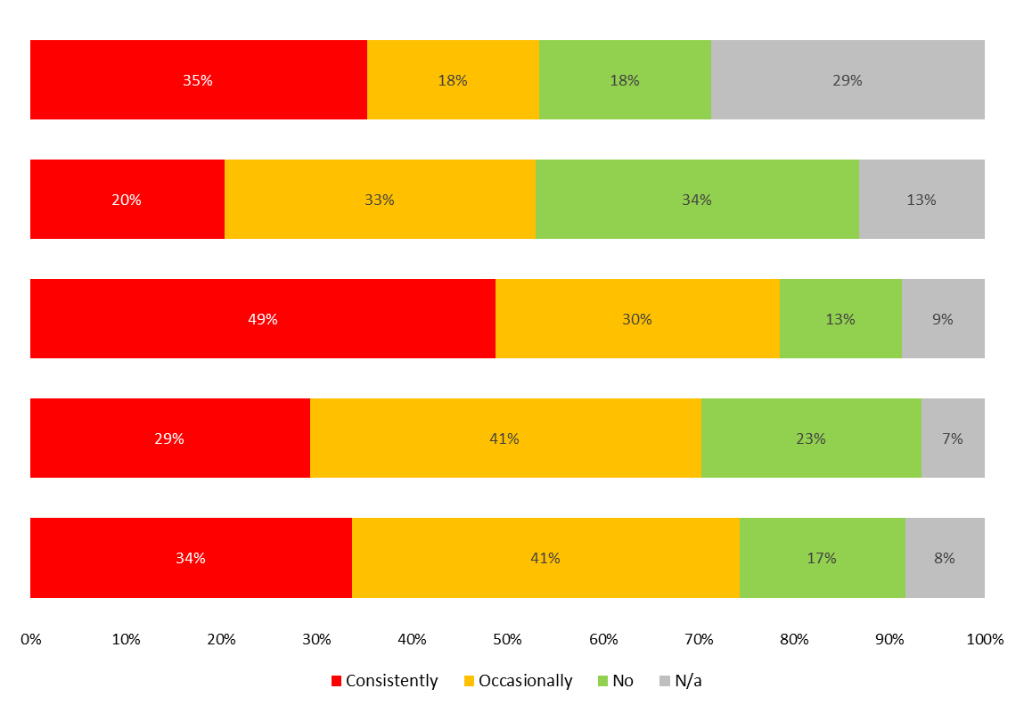
Impact of the cost of living crisis on healthy lifestyles
Stopped going to the gym/leisure centre; or went less often
Cooked at home less (for example, to save on energy bills)
Cooked at home more
Chose unhealthy or fast food options over healthier ready meals because they were cheaper
Chose less healthy ingredients when cooking at home because they were cheaper

Slide 39


What we know about vaccines and vaccine hesitancy
in Tower Hamlets and Waltham Forest
GP surgeries- what makes a difference
Higher Covid vaccination rates in Tower Hamlets and Waltham Forest GP practices were correlated with:
All of these correlations were stronger in relation to the 2023 seasonal Covid vaccine booster than with initial Covid vaccines pre-2023; which indicates an increasing importance of these factors.
Patients feeling treated with care and concern.
Patients believing the appointments they get at their GP practices meet their needs.
Patients feeling listened to by healthcare professionals.
GP surgeries in more deprived areas also had lower rates of Covid vaccines than those in more affluent areas.
Patients feeling involved in decisions about their own care and treatment.
Patients believing they are given enough time during medical appointments.
Patients trusting medical professionals in the practice.
Patients feeling that their mental health needs are recognised.
Patients finding reception staff helpful.

Slide 40
How to engage on vaccines
in an accessible, person-centred way that shows competence and builds trust
The Bangladeshi community
The Pakistani community
Higher levels of trust in GPs, the NHS and scientists; less trust in online information.
Lower trust in GPs, more likely to seek information online or through friends/ family.
Levels of literacy and digital inclusion may vary, with a generational element- GPs especially important for those with lower levels, especially those perceived by patients as good and supportive.
People perceived as prestigious can be effective influencers (for example: someone running a successful local business)
Government/WHO websites and BBC News are trusted sources of info.
The African/Caribbean community
Children and young people
High levels of trust in the NHS brand, but not necessarily individual local GPs.
Reliant on parents or school for information; some may feel that decisions about vaccines are up to the school/parent, not them.
Likely to seek out information online.
For early childhood vaccinations, health visitors can play an important role in communicating with parents.
Some may prefer information NOT to be in writing. NHS-produced online videos or reels could be effective for engagement.

