Slide 1
Neighbourhood Working – NEL context and Waltham Forest context
Patient Participation Group meeting
September 2025

Slide 2
What is neighbourhood working?
Outlined in the NHS 10-Year Plan:
A shift toward integrated community‑based care: Neighbourhood Working promotes delivering more services in the community or at home, rather than hospitals. Focusing on prevention, improving access and patient experience and supporting longer, independent lives.
Collaboration through multidisciplinary neighbourhood teams: It formalises neighbourhoods where primary care, community services, mental health, social care and voluntary sector partners work together in integrated neighbourhood teams to reduce fragmentation and duplication.
Core model structured around six core components: The guidelines specify six scalable components (e.g. shared population health management, MDT triage, direct care, data-sharing infrastructure), offering local flexibility in how neighbourhood health is operationalized.
Primary care’s pivotal role in prevention, continuity and leadership: General practices and PCNs anchor neighbourhood models, leading MDTs, identifying high‑risk patients, supporting modern general practice (MGP), working with ARRS roles and coordinating with wider system partners for local accountability and shared population outcomes.
Three strategic shifts underpinning delivery
From hospital‑centred to community‑centric care,
From reactive treatment to proactive prevention,
From analogue to digital systems, leveraging tools like GP record systems, NHS App and shared data platforms
Notes:
Six core components
Population Health Management
Modern General Practice
Standardising Community Health Services
Neighbourhood Multidisciplinary Teams (MDTs)
Integrated Intermediate Care (‘Home First’)
Urgent Neighbourhood Services

Slide 3
Putting insight into action – what would success look like?
Competent and efficient
Person-centred
Accessible
Integrated
Caring
waiting times are reduced, access to services is quick, and use of resources is optimised to provide timely care to people
interventions are specific to each person’s unique circumstances, leading to better health outcomes and patient satisfaction
services are easy to reach for everyone, regardless of their location, socioeconomic status, or physical abilities - including both physical access and access to information about health
people receive coordinated care across all levels of the health and care system, from primary care to specialised services, and ultimately leading to a more holistic approach to health
the emotional and psychological well-being of patients is prioritised, ensuring that they feel supported and understood throughout their health journey
Equitable
Prevention focused
Transparent and trustworthy
Empowering
disparities in health outcomes are eliminated and all people receive the care they need
Collaborative
partnerships between different healthcare providers are at the forefront of delivery, as well as the relationship between health and care providers and local people
healthy lifestyles, early detection of diseases, and preventive interventions are promoted, ultimately leading to a healthier population
patients are well-informed and can trust the health system to act in their best interests
self-help and patient involvement in decision-making are encouraged, leading to more engaged and informed local people

Slide 4
What does this mean for Waltham Forest?

Slide 5
Neighbourhood health – what have local people told us they need so far?
Insight is being continually gathered through:
Community forums, patient participation groups, patient experience groups from all partners
Working alongside the WF VCSE leadership group to reach in to communities
Waltham Forest Health Champions
The North East London People’s Panel
Previous insight from the Good Care Conversation
Engagement focussed on new services (e.g. WF Integrated Palliative Care service) and new programmes (e.g. locality hubs)
The Community Insight System
Targeted partnership engagement with specific communities – e.g. the Romanian community and young people
Neighbourhood health needs to be:
Competent and efficient
Person-centred
Accessible
Integrated
Caring
Equitable
Prevention focused
Transparent and trustworthy
Empowering
Collaborative

Slide 6

Vision and Mission
Vision (What)
"Everyone in Waltham Forest can live well from birth to old age, supported by joined-up health, care and community services that reduce inequalities and improve wellbeing in every neighbourhood."
Mission (How)
"We bring together partners across health, care and the community to deliver neighbourhood, integrated, preventative and person-centred support. We listen to residents, empower staff, embrace diversity, and focus on sustainable change that meets local needs and aligns with national priorities."
Next steps - Test the vision and mission with residents, including attending meetings to gather feedback and ensure the vision/mission statement aligns with community needs.

Slide 7
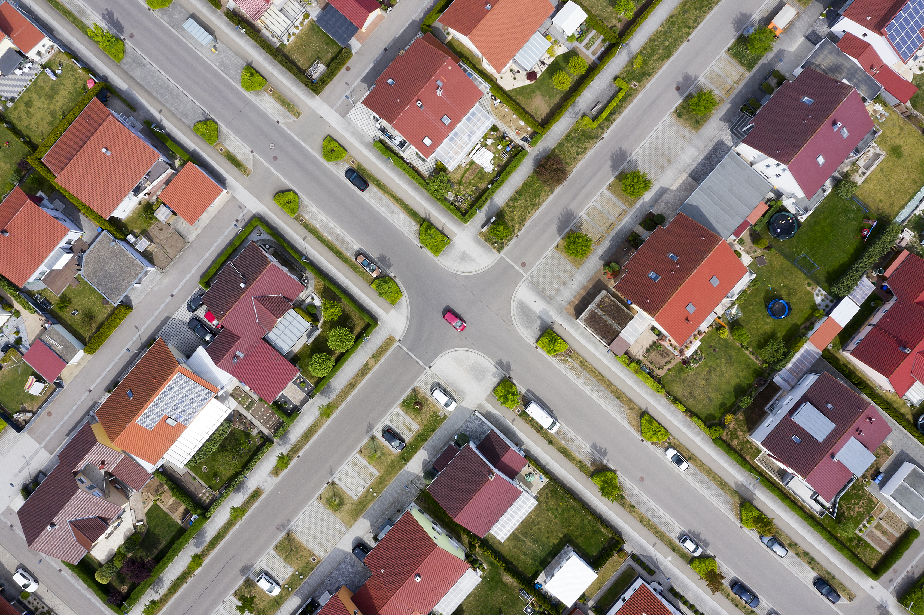
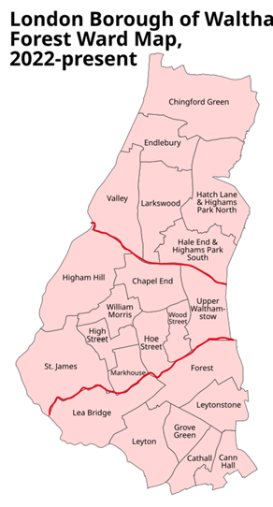
Neighbourhoods in Waltham Forest
3 neighbourhoods agreed - North, Central and South
Boundaries based on electoral wards which mainly aligns with services already e.g. LBWF stronger communities, NELFT CHS/MHS
Alignment considerations
Reconfiguration of PCN’s to align to 3 defined neighbourhoods
NELFT CHS/MHS align except for Lea Bridge ward in ‘South’ neighbourhood
Aligns with LBWF configuration for neighbourhoods/stronger communities
Population per neighbourhood
(Based on 2021 Census)
North = 71,111
Central = 107,638
South = 99,682
Next steps – Further engagement with providers/stakeholders e.g. Primary Care and NELFT to complete alignment

Slide 8

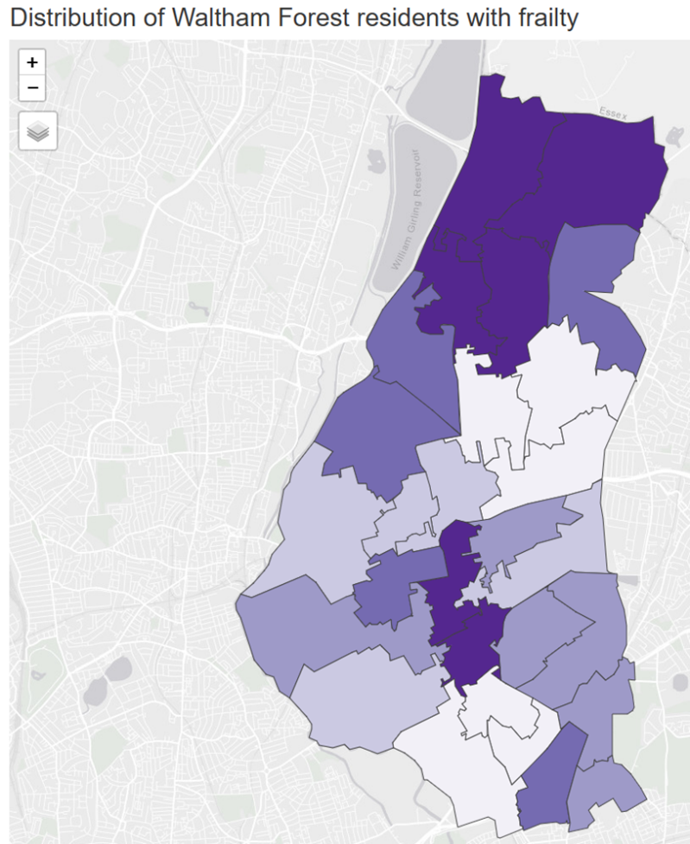
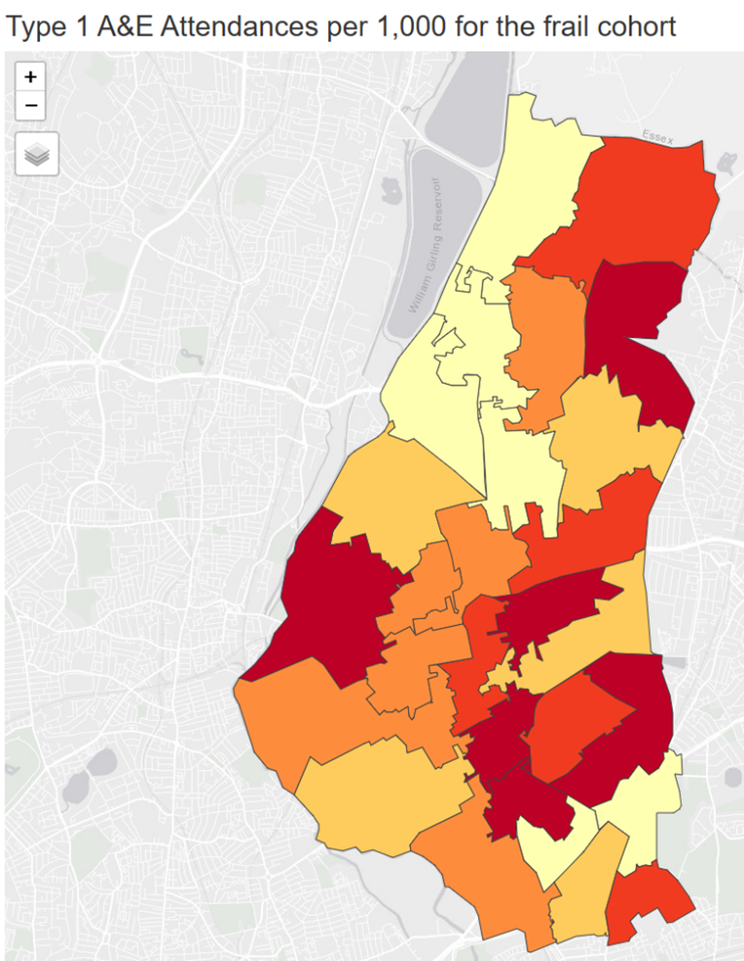
Identifying which groups to work with
Use of population health data to identify the health and care needs of those within the neighbourhoods i.e. North, Central and South - all age.
WF Population Health Data Group to be set up
Example - Frailty
Most of Waltham Forest’s frail population lives in the North neighbourhood although there is also a concentration around the Central area.
However, the distribution of the frail cohort access Type 1 A&E care is more dispersed (Central and South Neighbourhoods i.e. Higham Hill, Wood Street, Hatch Lane and parts of Lea Bridge and Leyton).
Next steps – Set up local Population Health data group to review NEL Population Health data at neighbourhood level and identify potential areas of focus

Slide 9

Approach
Use population health information to identify specific areas/cohorts, then prioritise the current pathways/teams involved to test the neighbourhood working approach to enhance/improve the pathway and outcomes.
Transformation and provider delivery model approach
Use data and resident voice to evaluate impact
Transitional approach – build on things already in place, specific focus, start small and expand over time.
Next steps – Repurpose WF Proactive Care Executive to become the Neighbourhood Working Delivery Board

Slide 10

Things already in place we can build upon
We have already started to scope Frailty pathways with Barts Health and NELFT using the development of the Locality Hub in Coronation Square as an enabler to support a neighbourhood approach.
The new integrated model for Community Palliative Care service in Waltham Forest is being developed to increase current clinical capacity and ensure the service is delivered at a neighbourhood level for local people in a timely and accessible way.
We have already rolled out in 4 PCN’s a Proactive Care model of Multidisciplinary Team (MDT) Working across secondary, primary, community care and the local authority to work collaboratively to proactively manage those at risk to become high intensity users of services.
NELFT Community Health Services and Mental Health services are already provided in neighbourhood geographies

Slide 11

Proposed Governance
WF Health and Care Partnership Board
WF Executive – close oversight and delegated authority
Population Health and Data Group – review and evaluation of data, identifying areas of focus
Neighbourhood Working Delivery Board – partnership approach to lead on delivery
NEL Neighbourhood Working Group
Next steps
NEL ICB will be commissioning the integrator role and provider.
ICB Senior leaders will be meeting with stakeholder leaders to discuss
Integrator role - TBC
Next steps – Individual partners and stakeholders to nominate members to form the Neighbourhood Working Delivery Board

